Slide 1
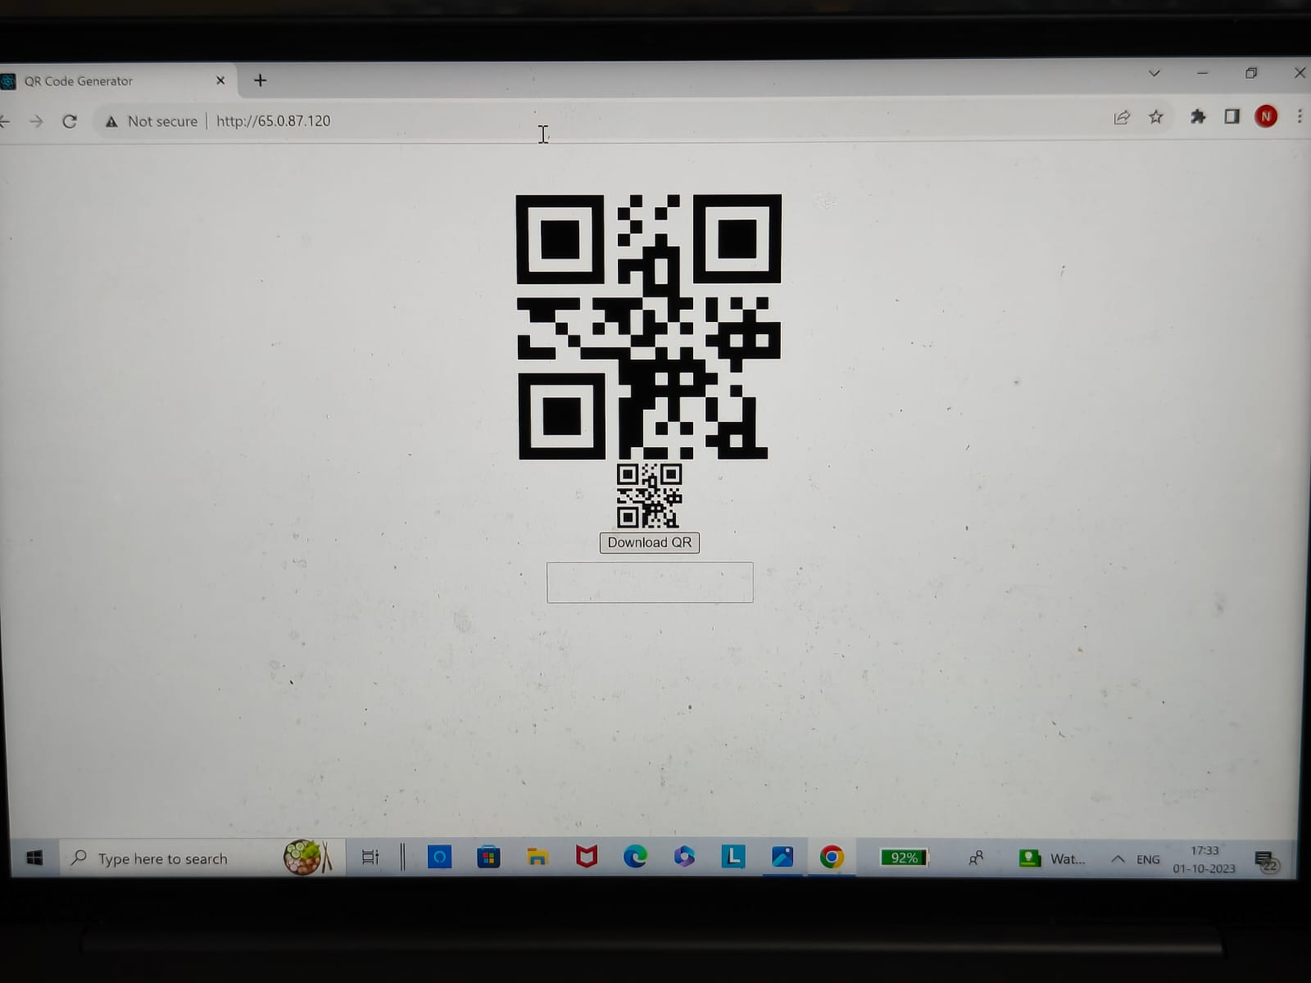
OUTPUT OF THE PROJECT

